Slide 1

QFE Week 2 Lab (/Lecture)!
Discuss the following with your classmates:
A statistic is said to be a resistant measure if it is not influenced the the presence of extreme observations.
Which measure of central tendency, the mean or the median, is more resistant?
Why?
Notes:
The mean is based on summing observations, so outlier (extreme) values will matter
The median is based on a ranked list, so what is going on at the edges does not matter
Draw the graph from 187 slides on the board

Slide 2

Probability!

Slide 3
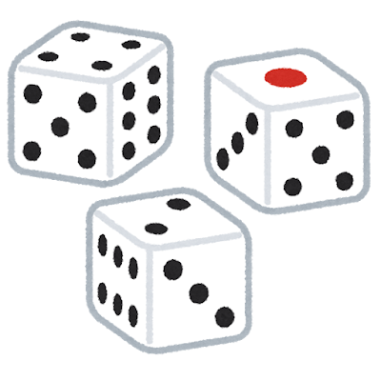
Probability!
Random Trial: A process with two or more possible outcomes
Outcome: A result from a trial
Event: A potential subset of of all possible outcomes
Probability of an event is the proportion of times the event would occur if we repeated a random trial over and over again under the same conditions
  quantifies the likelihood of an event we are unsure of
Notes:
Roll a die – we have 6 possible outcomes
Event could be “get an even number” ”get a number greater than 3”, or “get a 4” (event can be an outcome)
We are unsure of what results we will get for the event.
ASK: If the event is getting a 4 when I roll this die, are we sure of what will happen?
In nature we’re also unsure of things.

Slide 4
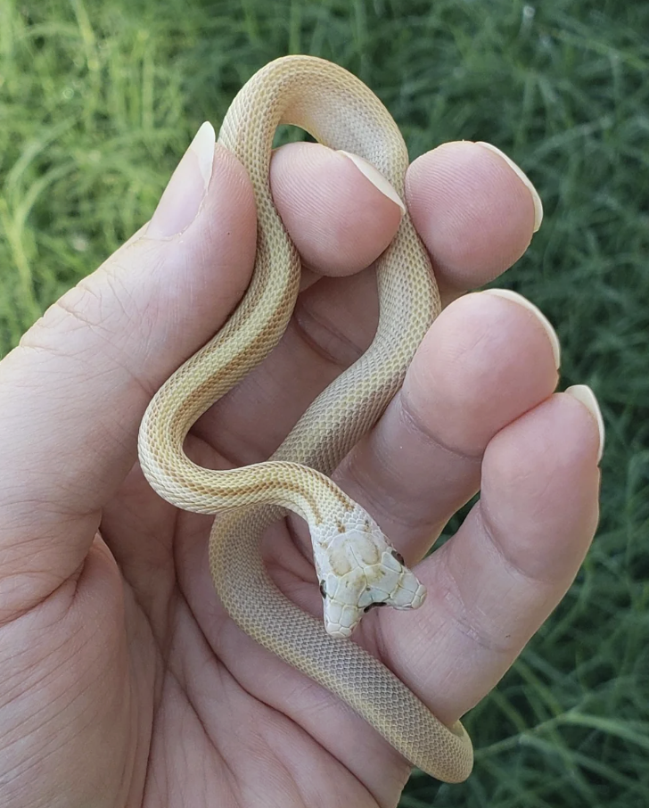
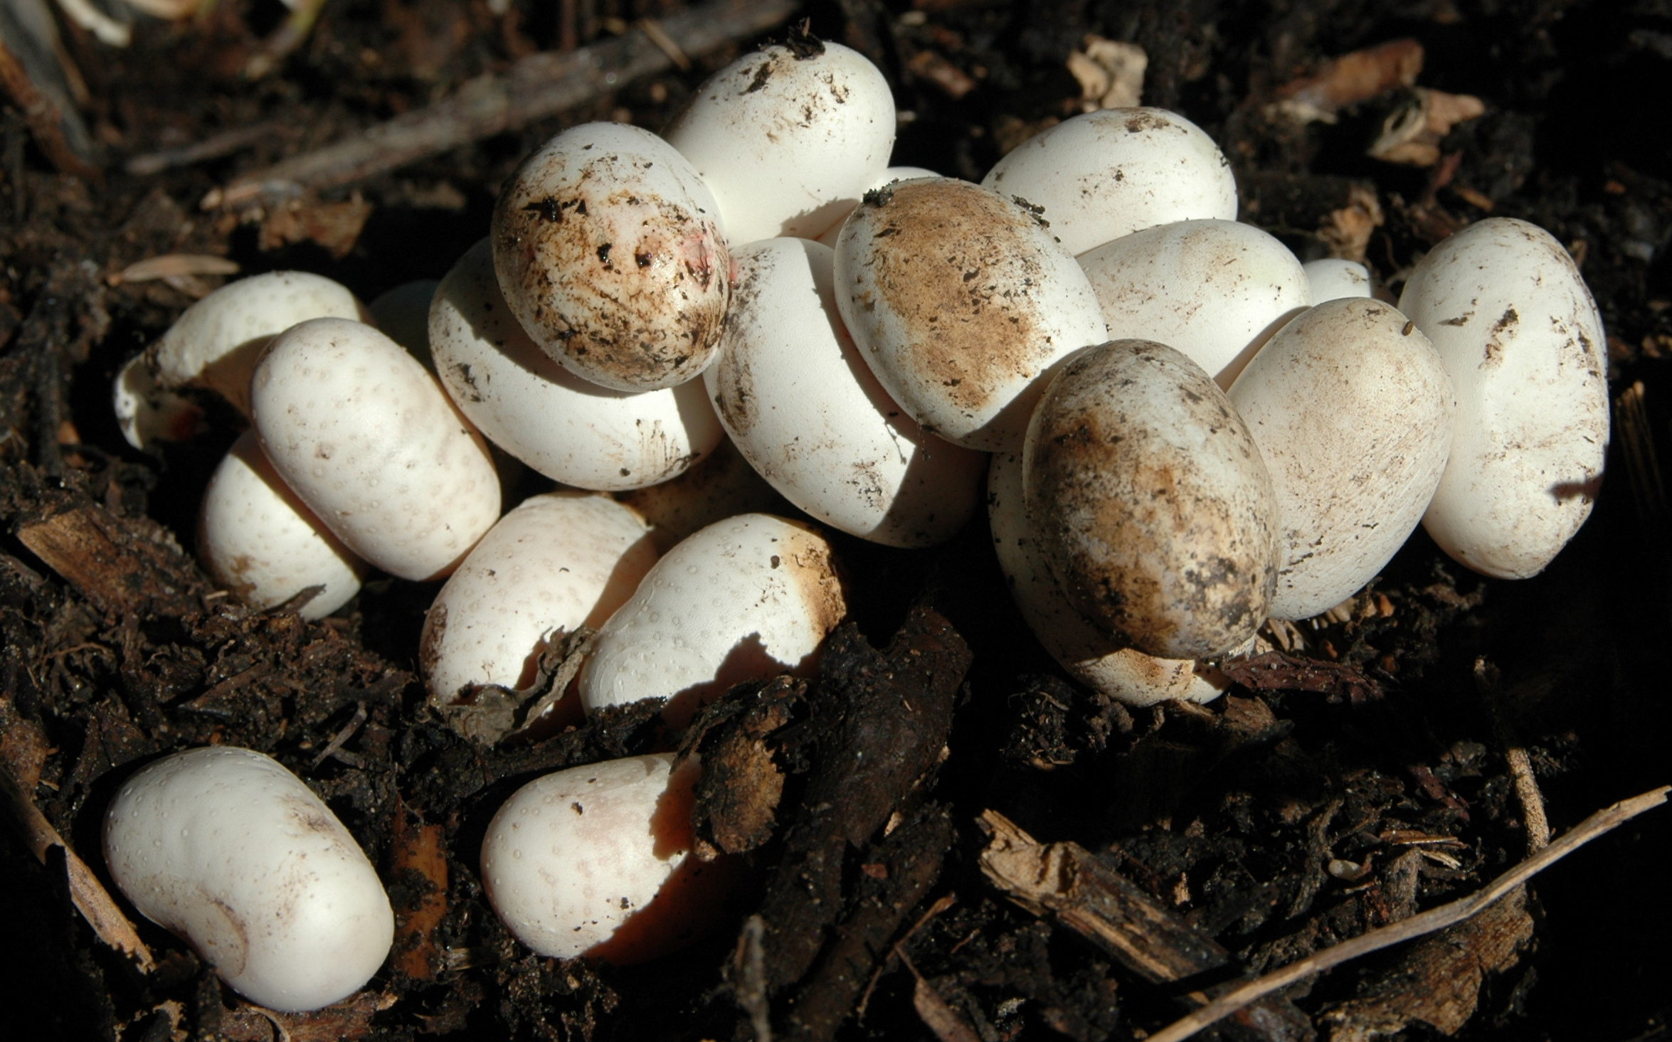
Natural Variation
Unsure because there exists natural variation
Biological systems incomprehensible without appreciation for natural variation
  What role does natural variation play in natural selection?
Notes:
Event being all of my snake eggs hatch with one head, we would be unsure of the results! Don’t know until we see all the snakes, lots of variation in nature.

Slide 5
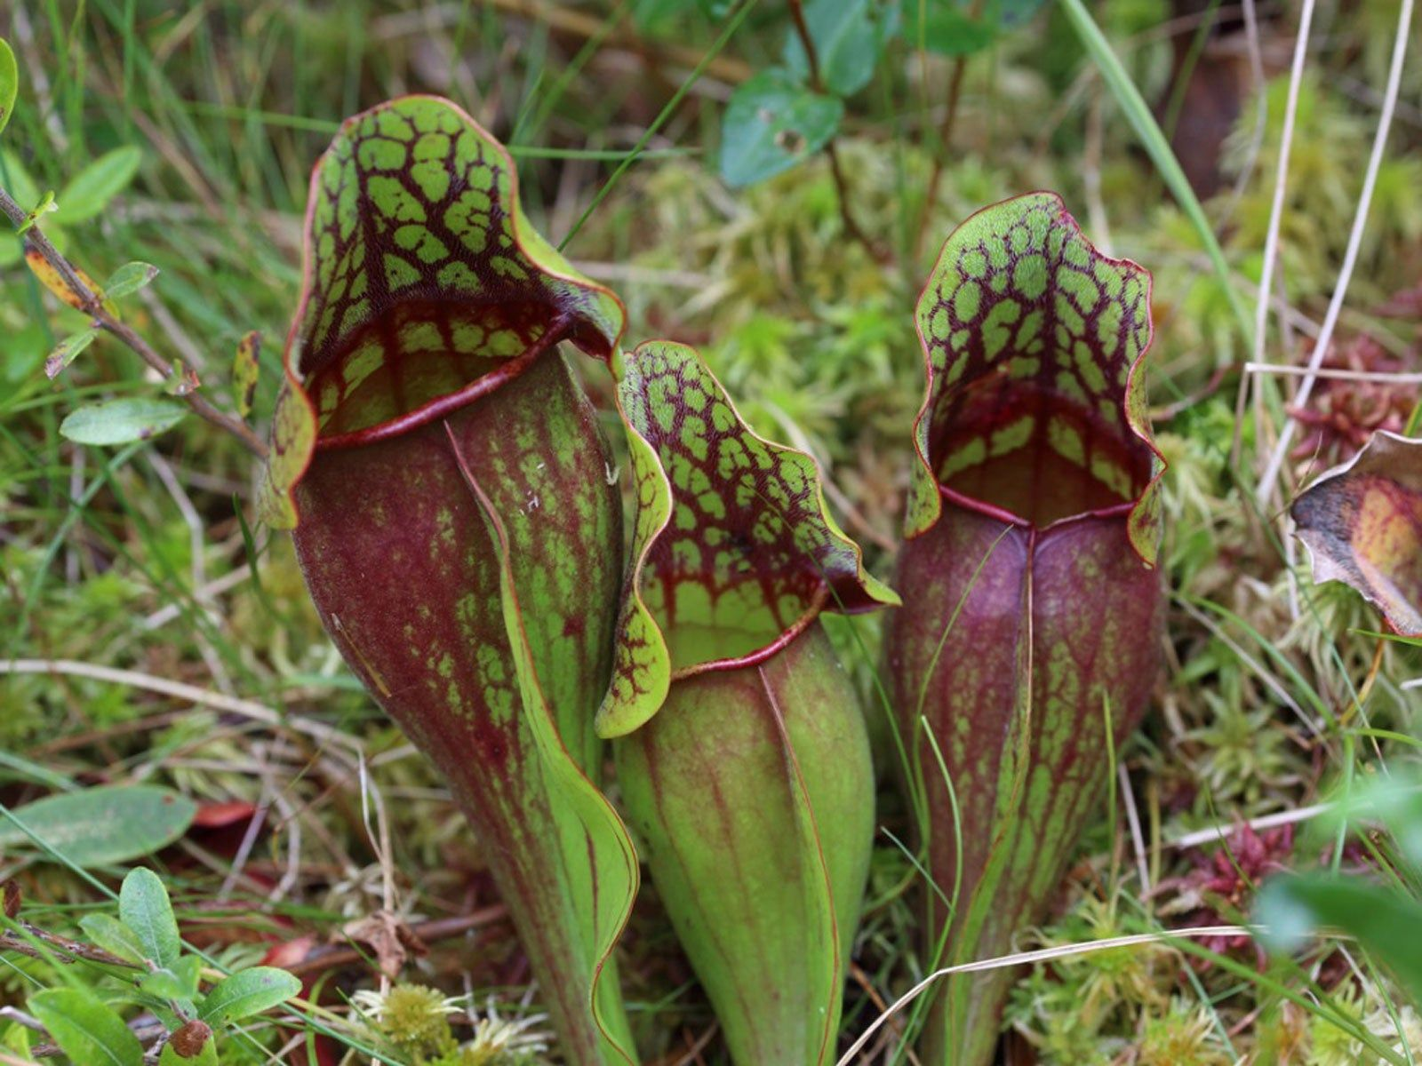
Wetland Example
How can we estimate the probability of an insect falling into the trap?
Track number of insects visiting
Two outcomes (discrete)
  Escape
  Capture
Record how many fall victim
Notes:
We’ve gone to a wetland and see these lovely pitcher plants, and we want to know more about the way they get their nutrients and feed on insects.
We have that inquiry that we talked about last week, observing and asking questions: What are the chances that a bug falls into the pitcher plant?
ASK: What is each insect visit? Trial!

Slide 6
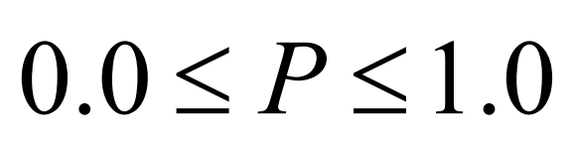
Wetland Example
Sample Space: Set of all possible outcomes
  Discrete sample space
Each insect visit is a trial, or replicate
Set of replicates is an experiment
3000 visits
30 captures
P(captured) = 0.01
Probability of the given outcome (capture), divide # outcomes by # trials
Notes:
Sample Space = event
Probability is always between 0 and 1, 0 if it never happens, 1 if it always happens.
Probability of the outcome of me getting ice cream, trial is me walking into an ice cream store. It will be 1. I will always get ice cream. Not many things in nature you can say that about though

Slide 7


Wetland Example
Maybe this was a good day?
Do the experiment repeatedly
  Sample the population to estimate P(capture)
Data then summarized in a histogram
  Frequency distribution of the data

Slide 8
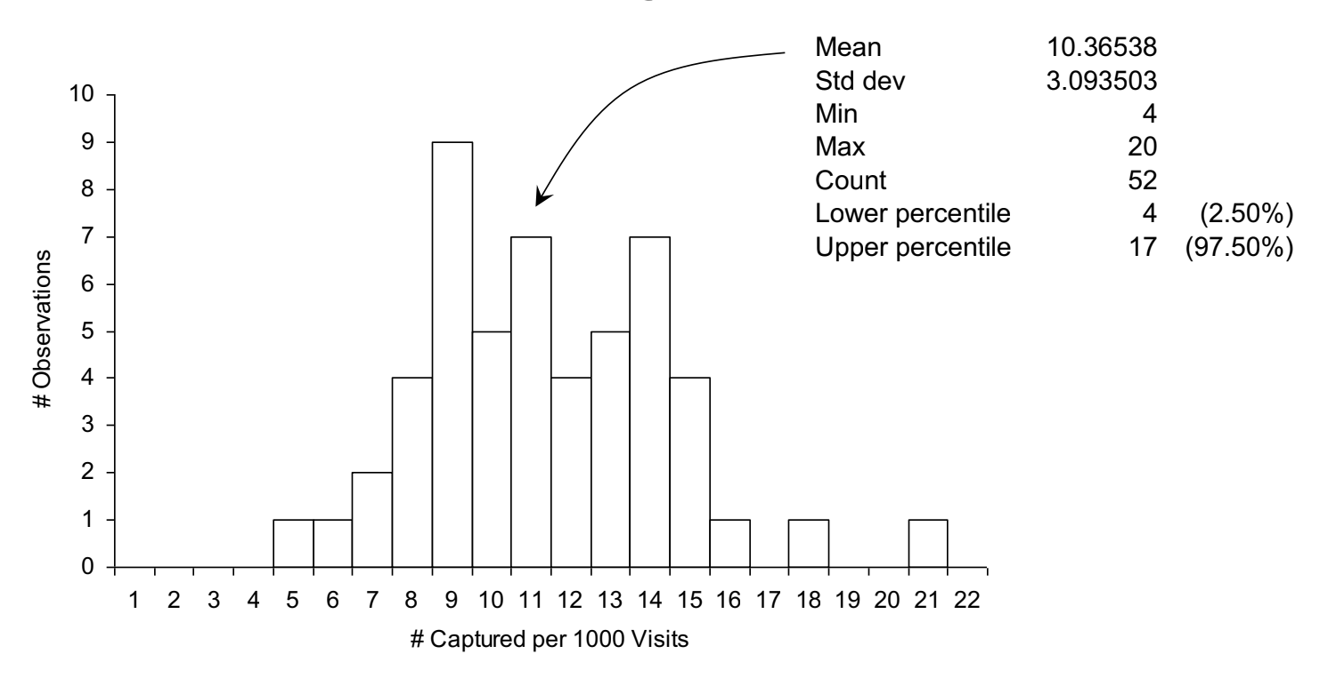
Wetland Example
Expected Value of the Probability = E(P) = 10.3/1000 = 0.0103
Notes:
Did the experiment 47 times (1000 trials/replicates of bug landing on plant)
Each time recorded the number of bugs that went in to the plant.
on average, It was 10.3 times

Slide 9
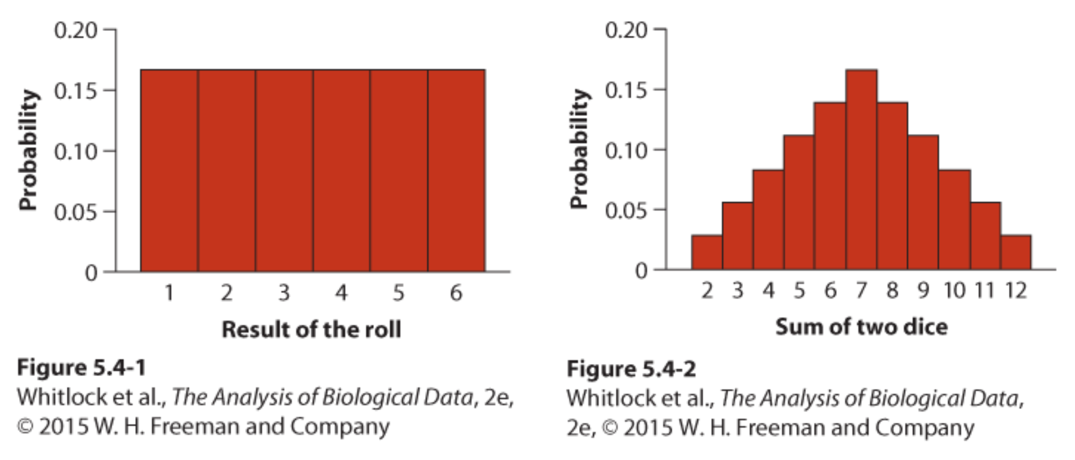
Probability Distributions
A list that describes the probabilities of all the possible outcomes of a random trial
Discrete: Describes the probabilities of categorical data or numerical data in discrete units, sum of all bars is 1
Discrete random variables take on finite, countable values
Notes:
Do trials, get the probability of things, and then we can describe it with these

Slide 10
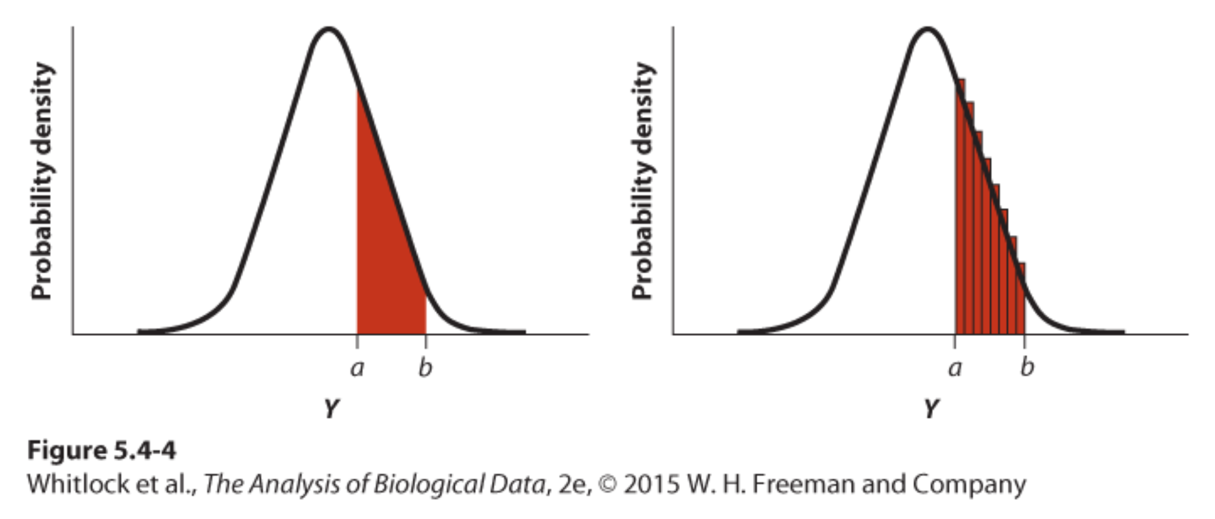
Probability Distributions
Continuous: Can be described with a curve that is known as the probability density
  Solve by finding the area under the curve between a and b
  Mathematically, we can solve for this using integrals
  The area under the entire curve is equal to 1
Continuous random variables take on any value within a smooth interval

Slide 11
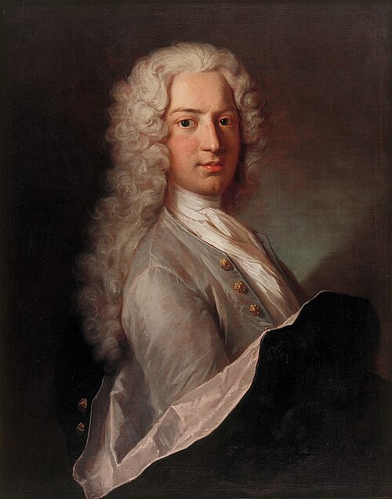
Bernoulli Trials
Experiment of independent trials where there can be only two outcomes (E.g., flipping a coin)
Note: Independence
  Two events are independent if the probability of one event does not influence the probability of another
  Probability that both events occur is the product of their individual probability (event a and event B)
Variable with many outcomes can be collapsed into a Bernoulli trial
Notes:
ASK: one student what they ate for breakfast and another student also what they ate for breakfast. The probability of student A eating X for breakfast impact the probability of student B eating Y for breakfast? No
Just like how seeing 5 sea urchins on one transect it won’t impact the amount of sea urchins I see on another.
However, the probability of me eating hot dogs at a bonfire does impact the probability of me having a stomachache after the bonfire.

Slide 12

Meadow Example
Occurrence of meadow beauty in Massachusetts
Survey many towns and collect data: presence, absence of the species
Assume P(present) = 0.02, P(absent) = 1-p = 0.98
Events must be independent
  P(occuring in two towns) = 0.02 x 0.02 = 0.0004
  P(occuring in 10 towns) = 0.02¹⁰ = 1.024 x 10⁻¹⁷
Notes:
There are many outcomes to the plants in the meadow, but we can collapse it into a Bernoulli trial – are the flowers there Y/N
Assume that the flower being in one town doesn’t affect the flower being in another.

Slide 13
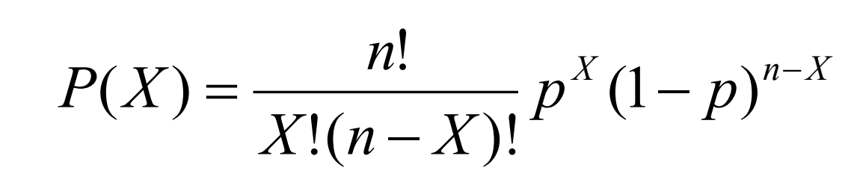
Many Bernoulli Trials = A Binomial Random Variable
The probability of getting X successes in n trials
p is the probability of success
  1-p is the probability of failure
n = total number of trials
X = total number of successes
n choose X is the binomial coefficient
Gets you every possible combination of success & failures
Factorial: gets big FAST

Slide 14

Binomial Distribution (Discrete)
Example: Flipping a coin
P(Heads) = P(Tails)=0.5
n = 25 (flip the coin 25 times)
X = outcome, binomial random variable
Probability = binomial formula
The probability density function assumes:
the number of trials (n) is fixed,
separate trials are independent
the probability of success (p) is the same in every trial.

Slide 15
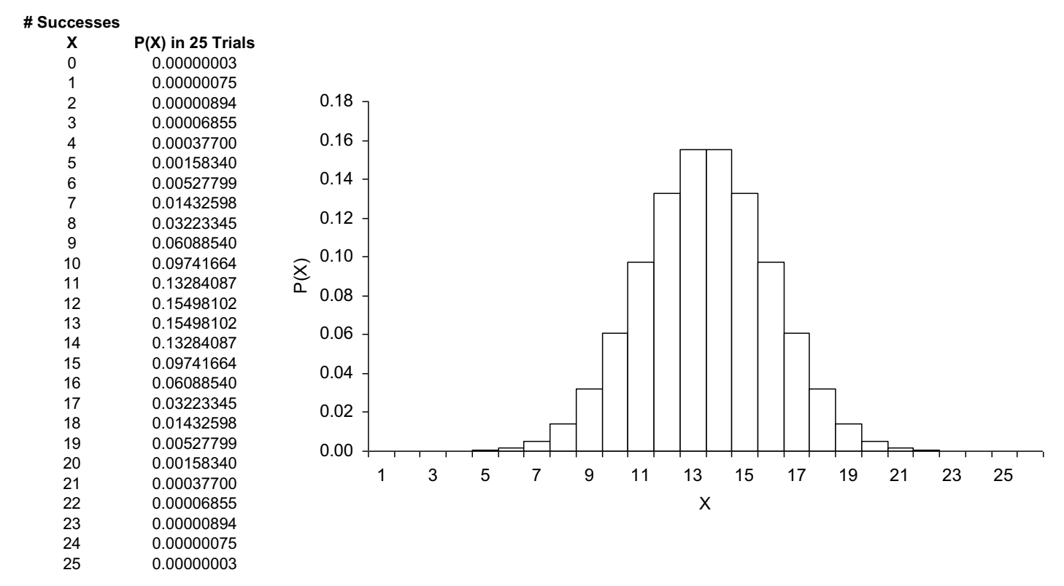
P(X)= 0.5
Notes:
If we have time we can actually test this lol

Slide 16
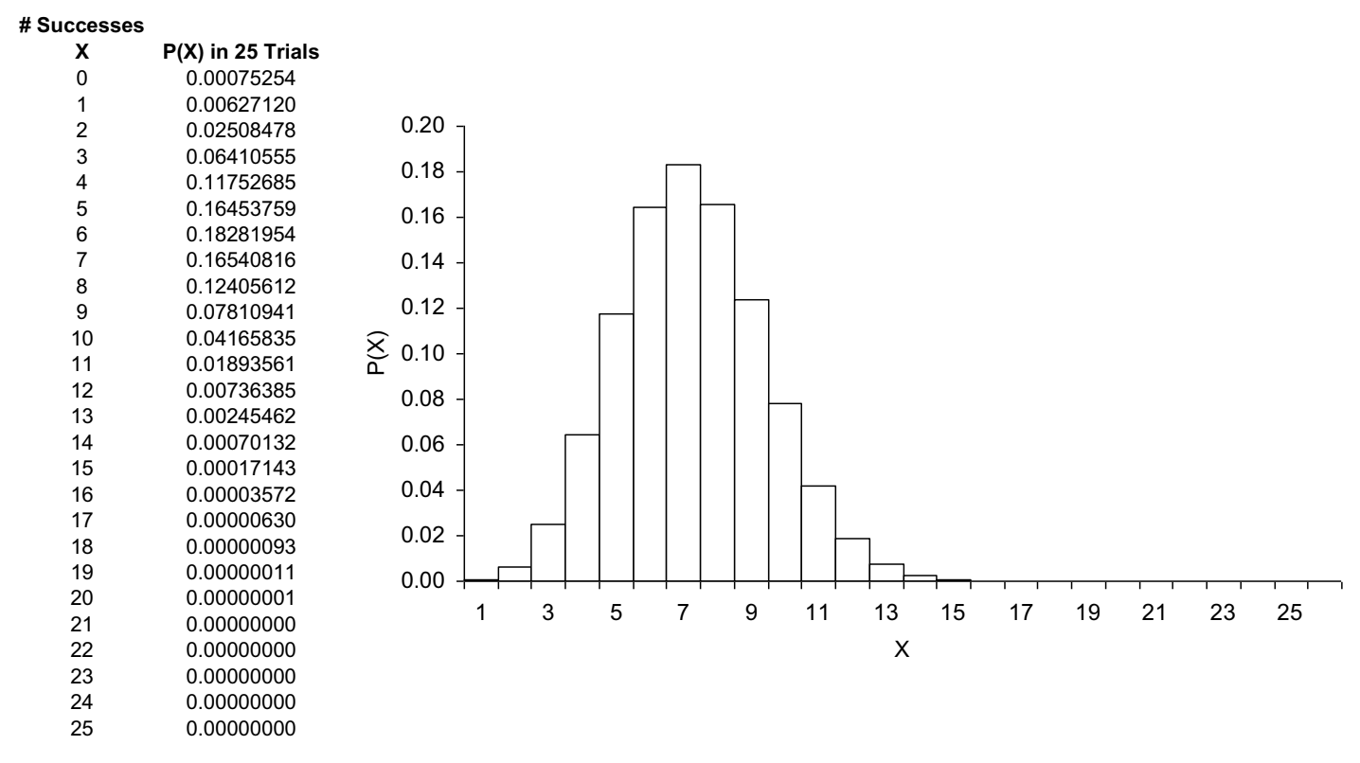
What if P(X)= 0.25

Slide 17
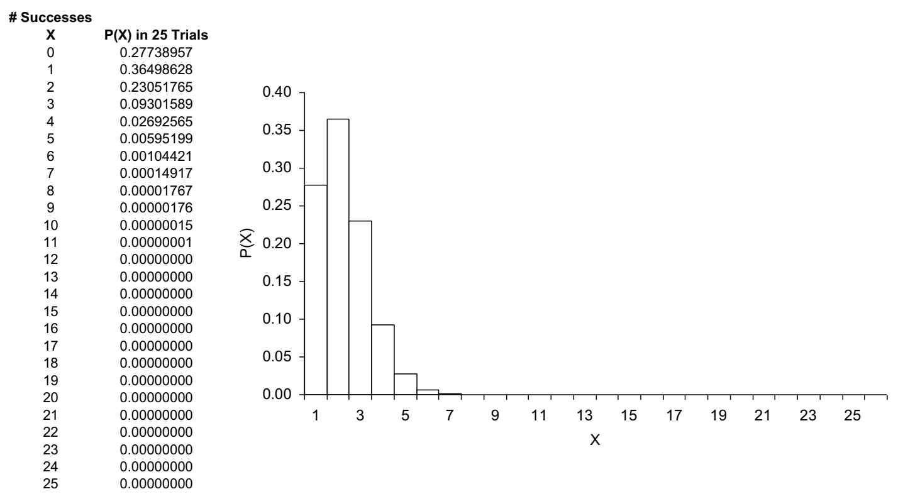
And P(X)= 0.05
Notes:
You can see the distribution function changing as the probability of success becomes lower!

Slide 18

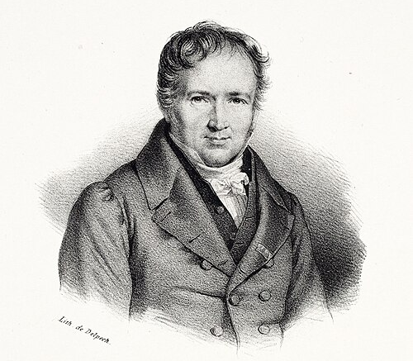
Poisson Distribution
Describes the number of successes in blocks of time or space, when successes happen independently of each other and occur with equal probability at every instant in time or point in space.
Asking whether events or objects occur randomly in continuous time/ space.
A reasonable expectation for certain biological counts,
  the number of salmon caught on a given day by each bear, number of seeds successfully germinated by each mother plant
Just a model – life gets interesting when the model doesn’t fit the data, because then we learn that one or more of the main assumptions is false
  some bears may be better catchers than others, or some plants may produce better-quality seeds

Slide 19

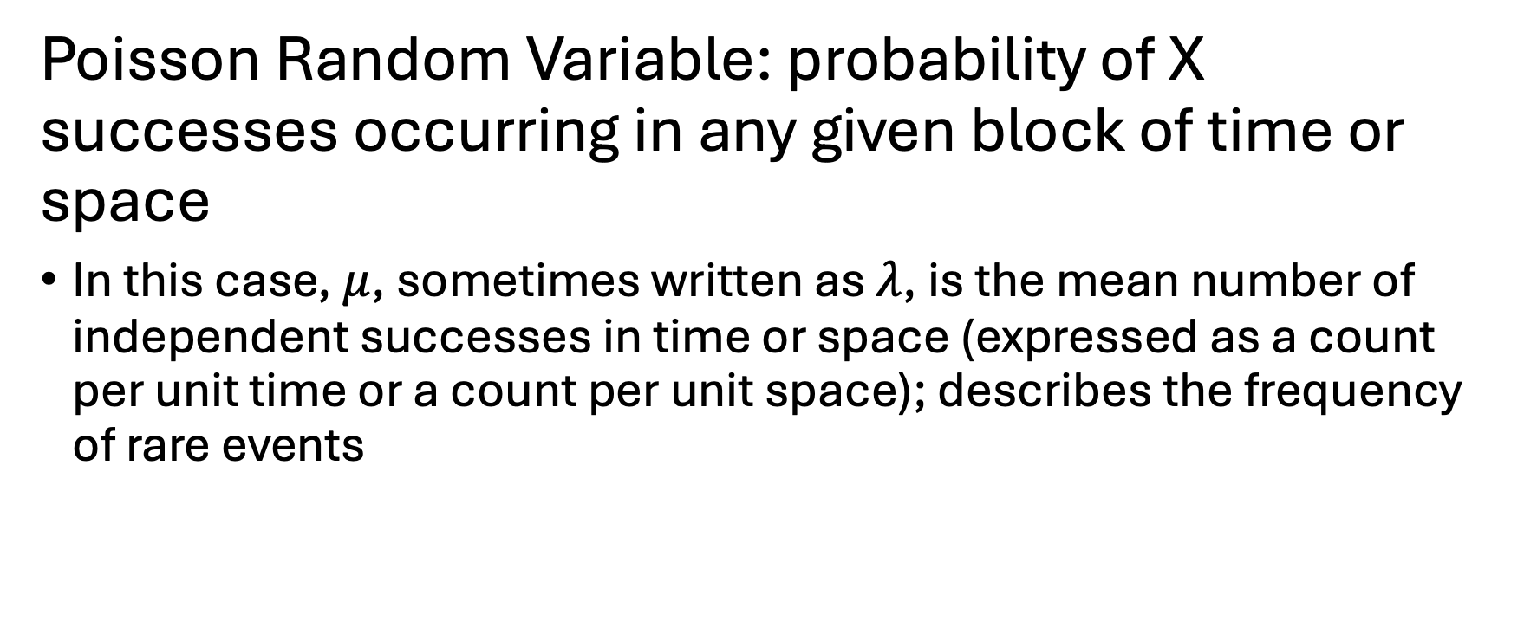
Poisson Distribution
Poisson Random Variable: probability of X successes occurring in any given block of time or space
In this case, $μ$, sometimes written as $λ$, is the mean number of independent successes in time or space (expressed as a count per unit time or a count per unit space); describes the frequency of rare events

Slide 20
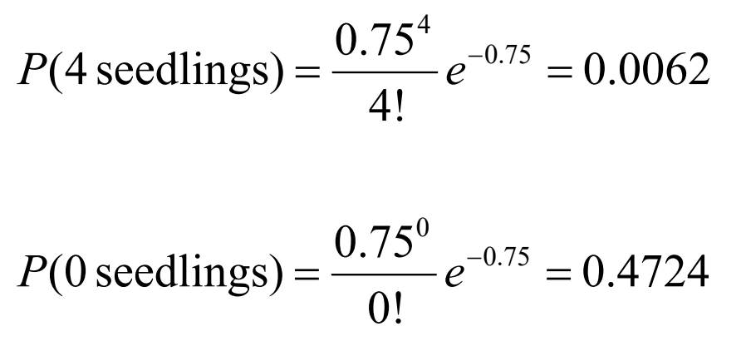

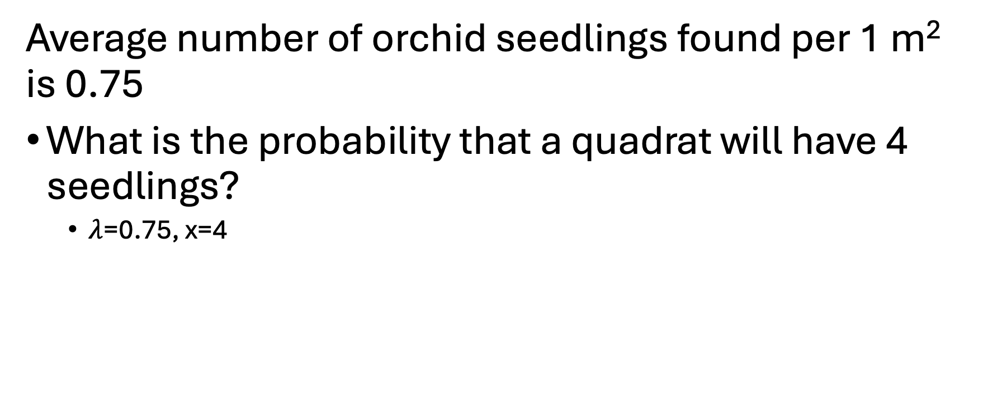
Poisson Example
Average number of orchid seedlings found per 1 m² is 0.75
What is the probability that a quadrat will have 4 seedlings?
  $λ$=0.75, x=4
Notes:
Did a bunch of 1 m2 quadrats, average number per quadrat is 0.75
ASK: Let’s say we surveyed 100 plots, then we would expect the number of plots that had no seedlings in them to be what?

Slide 21
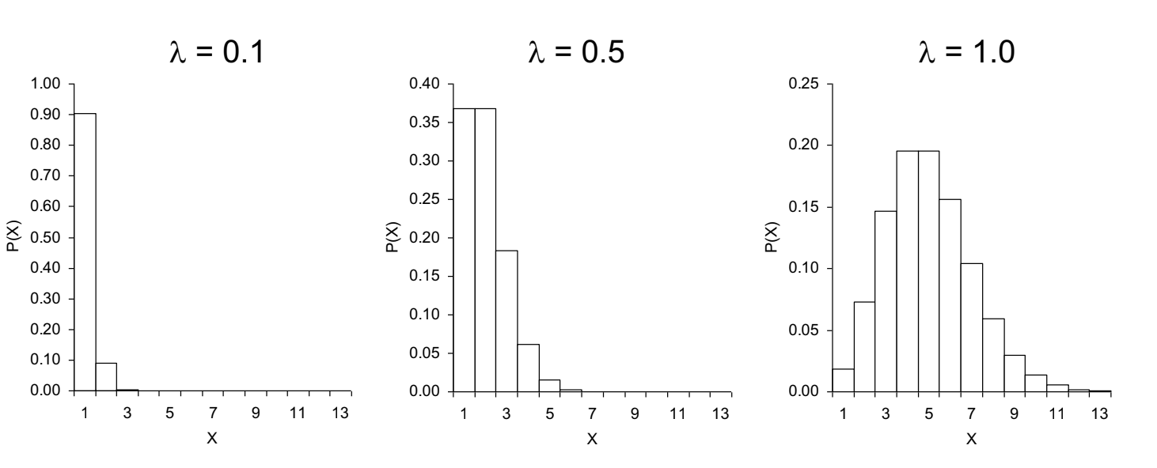
Poisson Distribution
Notes:
As the frequency/mean number gets larger, the distribution changes

Slide 22

Continuous Random Variables
The value of a variable measured on a randomly sampled individual is an outcome of a random trial.
Meaning, something like randomly sampling an individual from a population of sockeye salmon to see what its weight is is an outcome of a random trial!

Slide 23
Continuous Random Variables
Precision limited only by instrument – counting eggs that hatch (discrete #) vs weighing baby birds
Cannot define the sample space like we did with discrete distributions (many possible outcomes)
Outcomes are defined by intervals
  1.5 < X < 2.5
  Rules of probability still hold for these intervals
All probabilities in the space must sum to 1
Probability of an outcome is defined by interval
  Equal the area under the curve that defines the interval

Slide 24
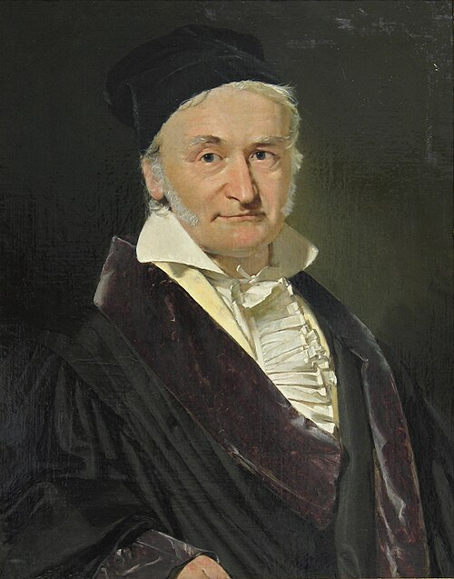
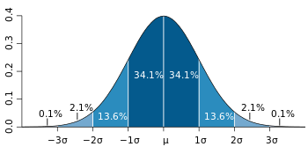
Normal (Gaussian) Probability Distribution
Theoretical basis for many parametric statistics
Mean = μ
Standard Deviation = s
Standard Normal: μ = 0, s = 1
μ ±1 s =~68% of data
μ ±2 s =~95% of data
μ ±3 s =~99% of data
Notes:
Analytically, this is easy to work with. Hence why so many statistical tests and formulas use it!
A lot of the stats tests we do rely on this normal distribution – there are some that don’t though!

Slide 25
Let’s Poisson!
We’re going to go out to CERA and collect data to investigate whether a species is randomly distributed in our forest or not!
Get into groups of 2-3
If you don’t want your shoes to get dirty, you’re welcome to use the boots!

